Slide 1
A Comparative Study of Machine Learning for Predicting Multiple Diseases
Mehadi Hasan Reg No. 46341 Exam Roll: 180696 Session: 2017-18 | Sohanur Rahman Reg No. 47939 Exam Roll: 180703 Session: 2017-18
Dr. Israt Jahan
Professor
Department of Computer Science
and Engineering
Sunday, May 28, 2023

Slide 2
Outline
Overview
Motivation
Objectives
Problem Definition
Existing System
Literature Review
System Model
Experimental Results
Conclusion & Future Scope
References

Slide 3
Overview
"Take care of your body. It's the only place you have to live." - Jim Rohn
"Your body is your most priceless possession. Take care of it." - Jack Lalanne
With the progress of society, people’s living habits and environmental conditions are gradually changing, which invisibly increases people’s hidden dangers of various diseases.
Health is wealth. So if anyone who is currently ill must see a doctor, which is both time consuming and costly.
Sometimes it might also be challenging for the patient if it is out of reach of doctors and hospitals.
So, if the following treatment can be performed using automated software that saves time and money, it may be better for the patient and make the process move more smoothly.

Slide 4
Motivation
A major challenge facing healthcare organization is the provision of quality services at affordable costs.
Quality service emplies diagnosing patients correctly and administering treatments that are effective
Poor clinical decision can lead to disastrous consequences which are therefore unacceptable.
Less availability of health care center.
Hospital must also minimize the cost of clinical tests.
They can achieve this results by employing appropriate computer based information and decision support system.

Slide 5
Objectives
The main objectives of this research is to develop a disease prediction system, the system can discover and extract hidden knowledge associated with disease from dataset.
This system aims to exploit machine learning techniques on medical data set to assist in the prediction of various diseases.
Provide a quick medical diagnosis to the patient living in rural areas.
Provide access medical specialists.
Reduce the cost of medical test.
To help avoid human biases.
This system can enhance quality of health care.

Slide 6
Problem Definition
Key Challenges in Multiple Disease Prediction System:
    Data Complexity
    Disease Interactions
    Imbalanced Data
    Feature Selection
    Model Interpretability
    Scalability and Real-time Prediction

Slide 7
Existing System
Very few systems use the available clinical data for prediction purposes and even if they do, they are restricted by large number of association rules that apply.
Diagnosis of the condition solely depends upon the Doctors intuition and patient’s records.
The disadvantages are:
Detection is not possible at an earlier stage.
In the existing system, practical use of various collected data is time consuming.

Slide 8
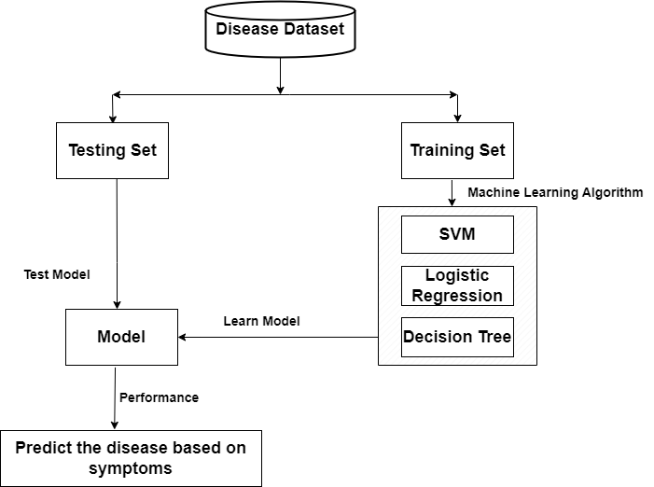
System Model
Proposed Model:

Slide 9
System Model cont…
Data Collection
As we have worked on multiple diseases that’s why their a variation in our dataset and all the datasets were downloaded from Kaggle.
Disease Name | Total Data | Disease Negative | Disease Positive | Data Type
Diabetes | 253681 | 213703 | 39978 | Numeric
Heart Disease | 319794 | 292422 | 27372 | Numeric
Pneumonia | 11697 | 3158 | 8539 | Image

Slide 10
System Model cont…
Data Pre-processing:
After downloading the data, the dataset is then split into two parts:
      Training set (75%)
      Testing set (25%)
Selecting Pre-trained ML Model:
There are four different kind of models present in our project to predict the disease these are
      Decision Tree
      Support Vector Machine
      Logistic Regression
      Convolutional Neural Network

Slide 11
System Model cont…
Testing and Selecting Model:
After running the model on training data, we ran all four model on testing data and obtained accuracy of each and every model. After comparing all the performance of the model we pick the best model for our “Multiple Disease Prediction” system.

Slide 12
Literature Review
Author | Title | Purposed | Algorithm Used and Accuracy
K. Arumugam, Mohd Naved, Priyanka P. Shinde, Orlando Leiva-Chauca, Antonio Huaman-Osorio, Tatiana Gonzales-Yanac | Multiple disease prediction using Machine learning algorithms-2021 | The goal of the project was to create a machine learning-based prediction system that, using patient data, could correctly forecast the risk of a variety of diseases, such as diabetes, hypertension, and coronary artery disease. | Naïve Bayes(78%) SVM(87%) Decision Tree(90%)
Emad Naushad, Bhavishya Raj, Arpit Nirvan, and Vrinda Sachdeva | Developing a Machine Learning-Based Multiple Disease Prediction System: A Comprehensive Analysis of Risk Factors and Disease Interactions-2023 | Allow end users to forecast chronic diseases without needing to consult a physician or doctor. Identifying various diseases by studying patients' symptoms and employing various Machine Learning Models approaches. | Logistic Regression(65.1%) SVM(75.4%)
Hitesh Bulani, Ajay Bhilare, Sahil Pandita, Ms. Farhana Shaikh | Multi Diseases Prognosis System using Machine Learning-2022 | By using Machine Learning the proposed system will detect the diseases in a better way. Types of disease like Allergy, GERD, Fungal Infection, Ulcers, Migraine, Diabetes, Jaundice, Malaria, Common Cold will be covered under this model. | Decision Tree (92%) Random Forest (89%), KNN(93%), Naïve Bayes(95%)

Slide 13
Literature Review cont…
Author | Title | Purposed | Algorithm Used and Accuracy
Aditya Ahirrao, Aditya Bhagwat, Pranali Desai, Sourabh Kaneri, Prof. Asma Shaikh | Multi Disease Detection and Predictions Based On Machine Learning-2021 | The proposed system consists of many diseases such as lung cancer, brain tumour, heart disease detections and stages predictions. The system for multi disease detection and stages predictions gives early detection and saves lots of life's by reducing death rate by chronic diseases. | CNN (83.7%)
Marouane Fethi Ferjani | Disease Prediction Using Machine Learning-2020 | The aim of this research is to recognize trends across various types of supervised ML models in disease detection through the examination of performance metrics. The analysis of ML models will be conducted on few diseases located at heart, kidney, breast, and brain. | CNN (84.5%), Logistic Regression (86.89%), Random Forest (96.27%), SVM (95.25%)
K.Gomathi, Dr. D. Shanmuga Priyaa | Multi Disease Prediction using Data Mining Techniques-2017 | Data mining techniques are used for predicting disease for this paper. Data mining techniques which can be used for predicting different types of diseases. This paper reviewed the research papers which mainly concentrate on predicting heart disease, Diabetes and Breast cancer etc. | Naïve Bayes(82.5%), J48(75.52%)

Slide 14
Experimental Result
From the previous referenced paper we find that these seven algorithms give the best result for the following types of predicted disease.
Algorithm | Disease Name
Support Vector Machine | Diabetes, Breast Cancer, Heart Disease, Hypertension, Parkinson’s Disease, Prostate Cancer.
Random Forest | Heart Disease, Diabetes, Breast Cancer, Hemoglobin variants, Lung Cancer, Micro RNA.
Decision Tree | Cerebral infraction, Heart Disease, Breast Cancer, Hemoglobin variants, Kidney Disease
Naïve Bayes | Asthma, Heart Disease, Prostate Cancer
Artificial Neural Network | Heart Disease, Breast Cancer, Stroke
K Neural Network | Heart Disease, Parkinson
Logistic Regression | Heart Disease, Liver Disease

Slide 15
Experimental Result cont…
Result Summary of Diabetes:
Result Summary of Heart Disease:
Model | Training Accuracy | Test Accuracy
SVM | 84.24% | 84.24%
Logistic Regression | 84.40% | 84.34%
Decision Tree | 99.33% | 76.63%
Model | Training Accuracy | Test Accuracy
SVM | 87.35% | 85.21%
Logistic Regression | 91.54% | 91.49%
Decision Tree | 86.24% | 86.12%

Slide 16
Experimental Result cont…
Model Summary of Pneumonia:
Model | Training Accuracy | Test Accuracy
Model-1 | 92.14% | 90.15%
Model-2 | 91.03% | 90.01%
Model-3 | 93.94% | 91.94%

Slide 17
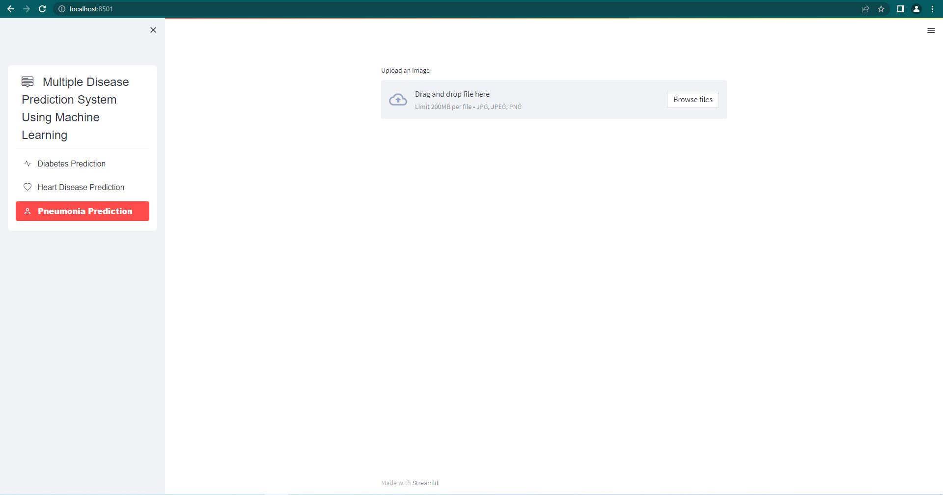
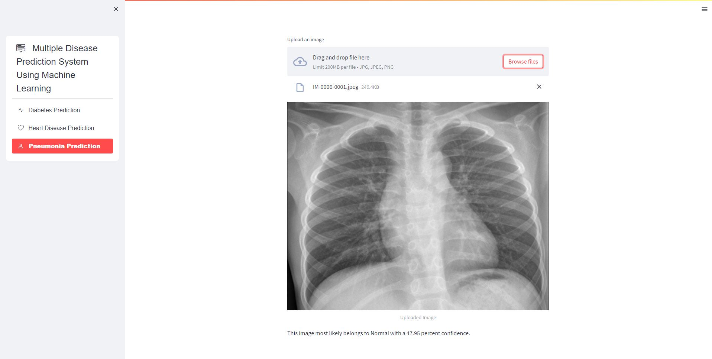
Experimental Result cont…
Output of the Project:

Slide 18
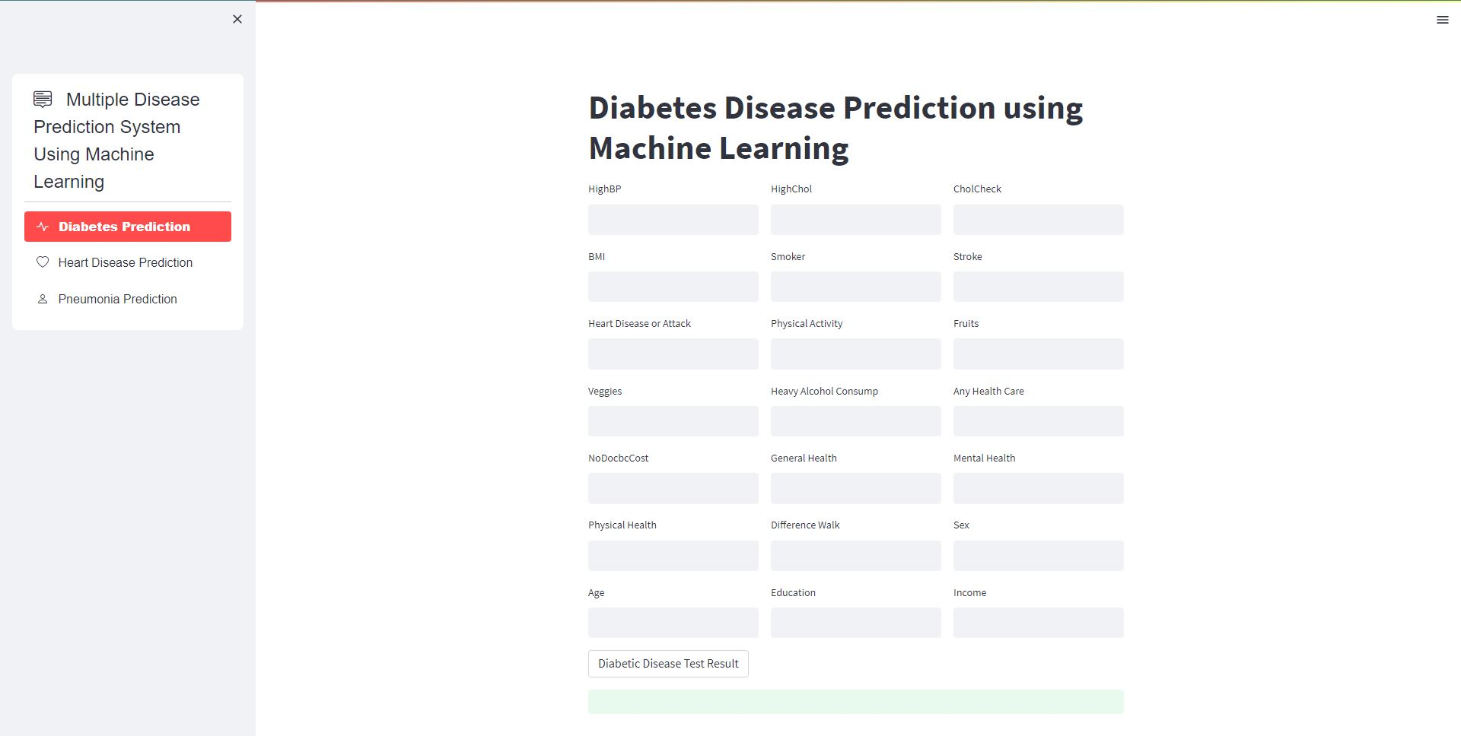
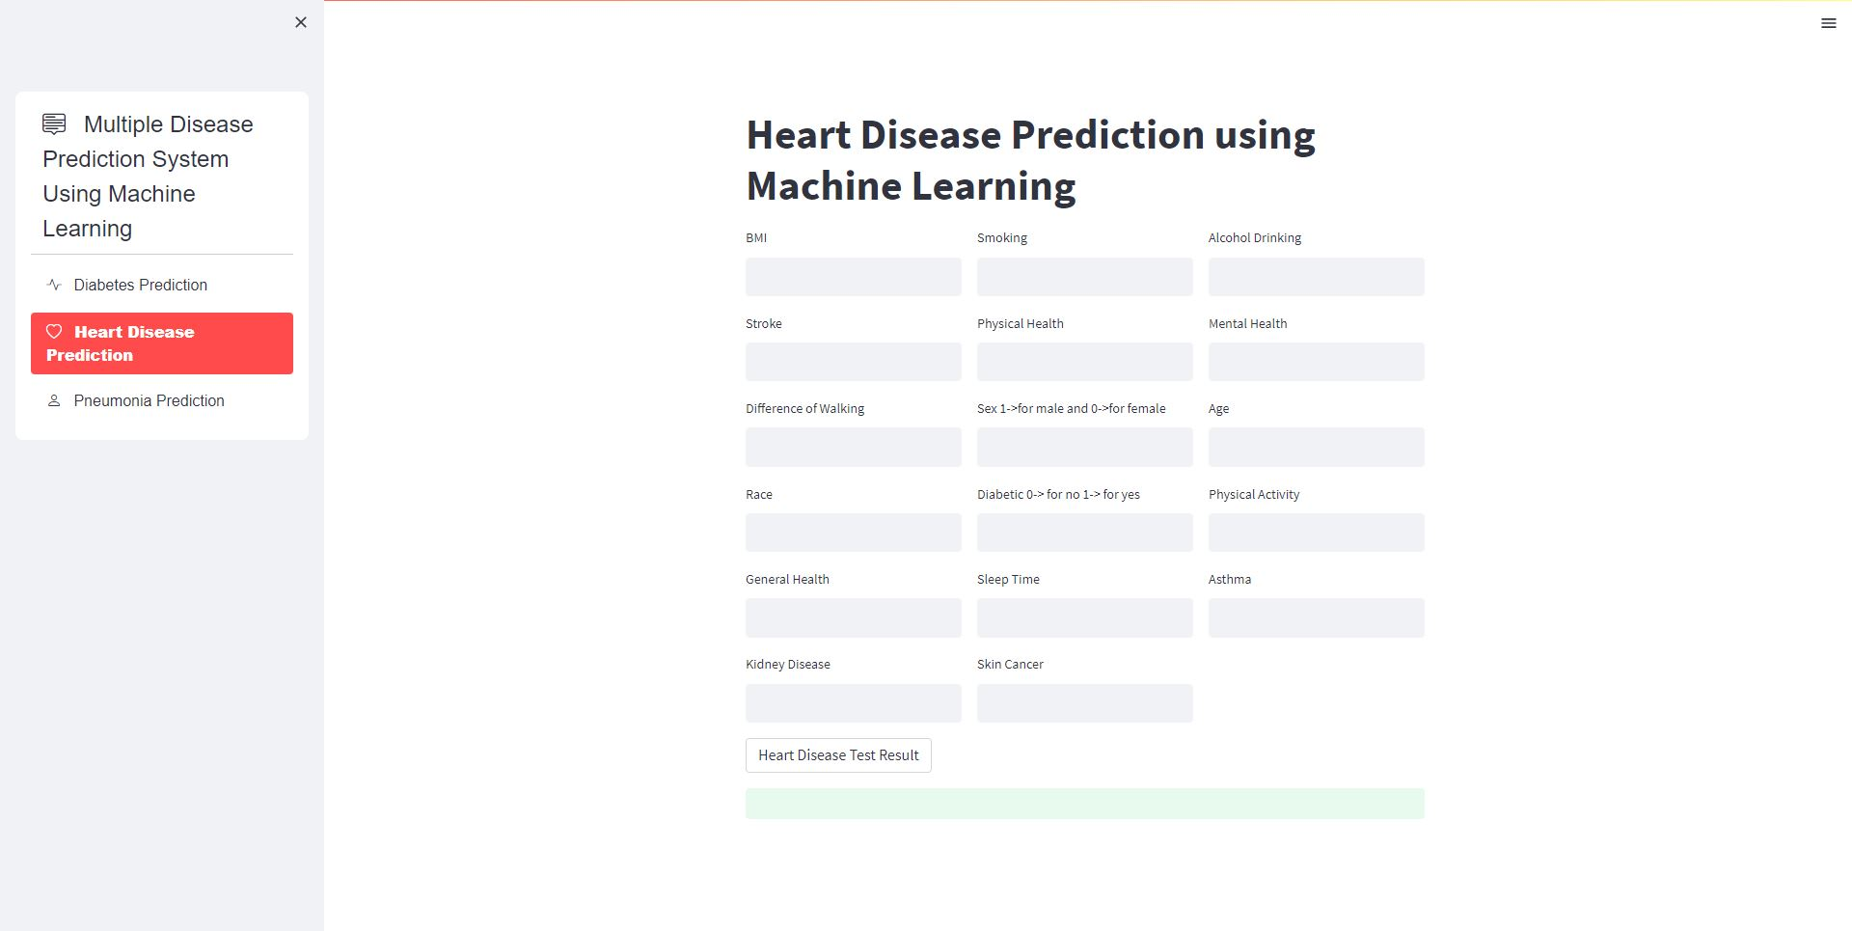
Experimental Result cont…
Output of the Project:

Slide 19
Conclusion and Future Scope
Based on the results of the above research, we were unable to achieve our aim of 100 percent accuracy in disease detection, indicating that there is still space for improvement.
Implementing deep learning algorithms will improve the accuracy of detecting disease.
For improvement is to expand the amount of the dataset; this would enhance the precision of the used algorithm.
Pneumonia, diabetes, and heart disease are the only diseases we are attempting to predict in this study; however, we plan to expand it to include many more diseases. Additionally, we will add material so that patients can consult our website for disease-related guidance.

Slide 20
References
[1] K., Arumugam & Naved, Mohd & Shinde, Priyanka & Leiva-Chauca, Orlando & HuamanOsorio, Antonio & Gonzales-Yanac, Tatiana. (2021). Multiple disease prediction using Machine learning algorithms. Materials Today: Proceedings. 80. 10.1016/j.matpr.2021.07.361.
[2] Naushad, Emad & Raj, Bhavishya & Nirvan, Arpit & Sachdeva, Vrinda. (2023). Developing a Machine Learning-Based Multiple Disease Prediction System: A Comprehensive Analysis of Risk Factors and Disease Interactions.
[3] Talasila, Bhanuteja & Kolli, Saipoornachand & Kumar, Kilaru & Anudeep, Poonati & Ashish, Chennupati. (2021). "Symptoms Based Multiple Disease Prediction Model using Machine Learning Approach", International Journal of Innovative Technology and Exploring Engineering. 10. 67-72. 10.35940/ijitee.I9364.0710921.
[4] Xie, Shuxuan & Yu, Zengchen & Lv, Zhihan. (2021). Multi-Disease Prediction Based on Deep Learning: A Survey. Computer Modeling in Engineering & Sciences. 127. 1-34. 10.32604/cmes.2021.016728.
[5] Bhilare, Ajay & Pandita, Sahil & Shaikh, Farhana & Bulani, Hitesh. (2022). Multi Diseases Prognosis System using Machine Learning. 10.13140/RG.2.2.35518.97602.
[6] S, Spandana & S, Sreedevi & B, Nishchala & Rao, Prerana. (2023). A Deep Learning Model for Human Multiple Disease Prediction Using VGG16. IJARCCE. 12. 10.17148/IJARCCE.2023.124114.
[7] Ahirrao, Aditya & Bhagwat, Aditya & Desai, Pranali & Kaneri, Sourabh & Shaikh, & Mohammad, Sameer. (2020). Multi Disease Detection and Predictions Based On Machine Learning. SSRN Electronic Journal. 7. 950-953.
[8] Ferjani, Marouane. (2020). Disease Prediction Using Machine Learning. 10.13140/RG.2.2.18279.47521.
[9] Kamaraj, K.Gomathi & Priyaa, D.Shanmuga. (2016). Multi Disease Prediction using Data Mining Techniques. International Journal of System and Software Engineering.

Slide 21
References cont…
[10] Ture, Tanmay & Sawant, Amol & Singh, Rohan & Patil, Prof. (2023). Multiple Disease Prediction System. International Journal for Research in Applied Science and Engineering Technology. 11. 1238-1244. 10.22214/ijraset.2023.49644.
[11] Maurya, Jyoti & Prakash, Shiva. (2023). Machine Learning based Prediction and Diagnosis of Heart Disease using multiple models. 10.21203/rs.3.rs-2642516/v1.
[12] Tandon, Sankalp & Chaurasia, Manoj & Singh, Vinit & Kumar, Udit & Kumar, Saurabh. (2023). A Machine Learning Model for Early Prediction of Multiple Diseases to Cure Life. 10.13140/RG.2.2.24229.37601.
[13] Babu, Sudheer & Dodala, Anil & Krishna, Siva. (2022). Intelligent Multiple Diseases Prediction System Using Machine Learning Algorithm. 10.1007/978-981-19-1412-6_55.
[14] Pattar, Abhishek & Kurhade, Sameer & Salunke, Manoj & Satav, Darshan & Priyadarshni, Prof. (2022). A SURVEY PAPER ON “MULTIPLE DISEASE PREDICTION USING MACHINE LEARNING”. International Journal of Engineering Applied Sciences and Technology. 7. 53-56. 10.33564/IJEAST.2022.v07i07.009.
[15] Muhammed, Saleh & Majeed, Ghassan & Mahmoud, Mahmoud. (2023). Prediction oh heart diseases by using Supervised Machine Learning. Wasit Journal of Pure sciences. 2. 231- 243. 10.31185/wjps.125.
[16] Keerthi, MS & Reddy, G. & Raghava, V. & Reddy, K.. (2023). Streamlit Interface for Multiple Disease Diagnosis. International Journal for Research in Applied Science and Engineering Technology. 11. 1159-1164. 10.22214/ijraset.2023.49166.
[17] Mishra, Dr & Pandey, Dr. Subhash. (2023). Multiple Disease Infection Prediction in Smart Societies Using Intelligent Machine Learning Techniques. 10.1007/978-3-031-28711-4_9.
[18] Pais, Mr.Sharan & K, Fayiz & Sharanya, & Shrihastha, & Varshith,. (2023). Disease Prediction using Machine Learning Algorithms. International Journal of Advanced Research in Science, Communication and Technology. 5-12. 10.48175/IJARSCT-7825
[19] https://www.youtube.com/watch?v=8Q_QQVQ1HZA&list=PLfFghEzKVmjuhQwKhYXvdU94GSU-6Jcjr

Slide 22
Thank You

